Slide 1
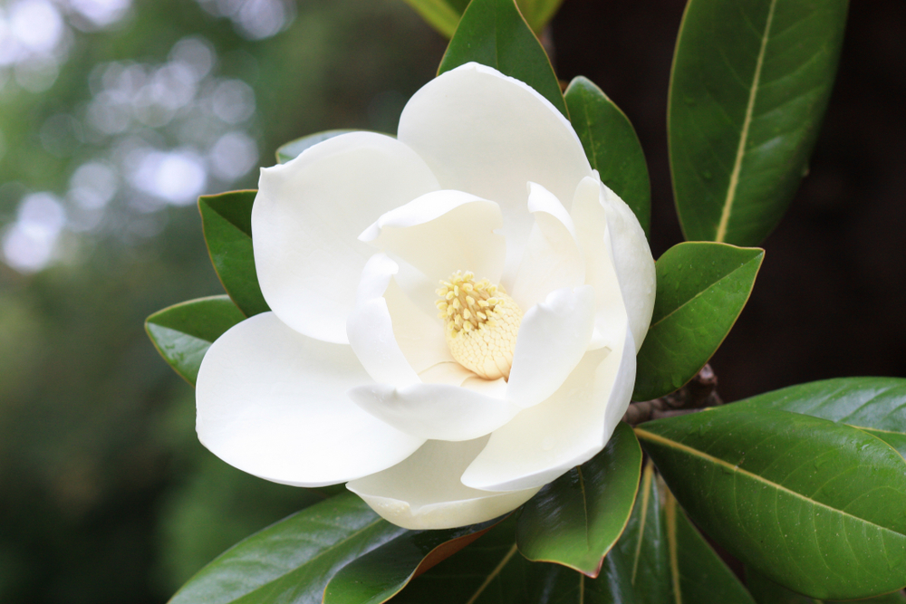

ANATOMY OF FLOWERING PLANTS

Slide 2
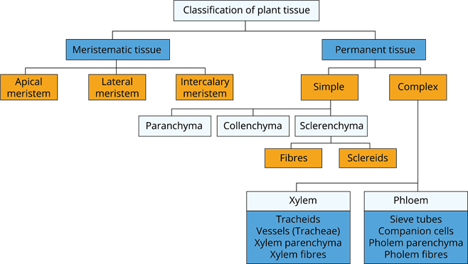

Slide 3
ANATOMY
Study of internal structure of plants is called anatomy.
THE TISSUES
A tissue is a group of cells having common origin and function.
Based on the capability of cell division, plant tissues are 2 groups
    Meristematic II. Permanent

Slide 4
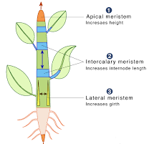
Meristematic tissues
These are the tissues where active cell division and growth occurs.
Based on the position, meristems are of 3 types:
  Apical meristem
  Intercalary meristem
  Secondary (Lateral) meristem

Slide 5
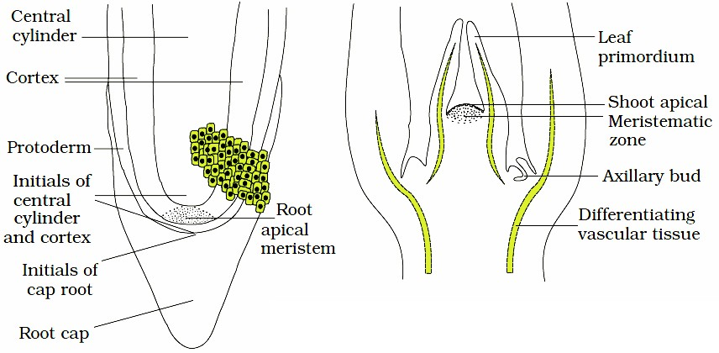
APICAL MERISTEM
They occur at the tips of roots and shoots and produce Primary tissues It is of 2 types:
a. Root apical meristem b. Shoot apical meristem

Slide 6
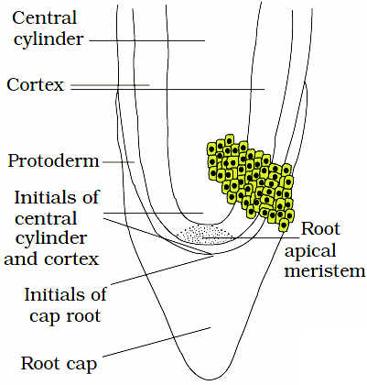
ROOT APICAL MERISTEM
It occurs at the tip of the root.

Slide 7
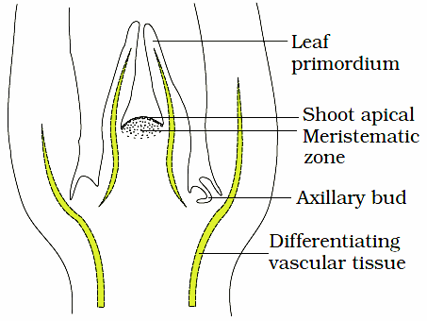
SHOOT APICAL MERISTEM
It occurs at the tip of stem axis.
Some cells left behind from shoot apical meristem form the axillary bud. They are present in the axils of leaves and become a branch or a flower.

Slide 8
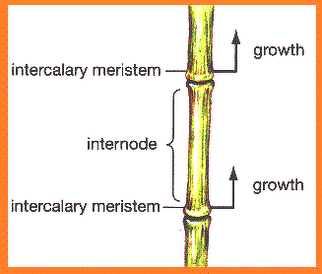
Intercalary Meristems
  They occur between mature tissues.
  Seen in grasses and regenerate parts removed by the grazing herbivores.
Apical & intercalary meristems are primary meristems because they appear early in a plant life and contribute to form primary plant body. During that, specific regions of the apical meristem produce dermal tissues, ground tissues and vascular tissues.

Slide 9
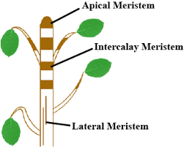
Secondary (Lateral Meristem)
  They are cylindrical meristems in mature regions of roots and shoots.
  Seen in gymnosperms and dicots.
  They produce secondary tissues.
  E.g. Fascicular vascular cambium, interfascicular cambium & cork cambium.

Slide 10
Class Assignment
All of the following are lateral meristems, except
1. Intercalary meristem 2. Fascicular vascular cambium 3. interfascicular cambium 4. Cork cambium
Axillary bud develops from
1. Shoot apical meristem 2. Root apical meristem
3. Intercalary meristem 4. Mature cells
3. Read the following statement regarding meristematic cells and select the correct one
i) Cells possess the ability to grow and divide
ii) Cells have dense cytoplasm with prominent nucleus
iii) Well developed ER and mitochondria are present
1. (i) and (ii) 2. (ii) and (iii)
3. (i) and (iii) 4. (i), (ii) and (iii)

Slide 11
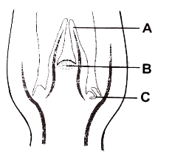
4. How many of the following are examples of lateral meristem? [Cork cambium, Intercalary meristem, Interfascicular cambium, Intrafascicular cambium, apical meristem]
1. 4 2. 3 3. 2 4. 1
5. Identify the given figure and select the correct option for A, B and C
 | A | B | C
1. | Leaf primordium | Shoot apical meristem | Apical bud
2. | Leaf primordium | Shoot apical meristem | Axillary bud
3. | Root hair | Root apical meristem | Axillary bud
4. | Root hair | Root apical meristem | Apical bud

Slide 12
6. Initial increase in length of stem or root is because of
1. Apical meristem 2. Intercalary meristem
3. Lateral meristem 4. Cambium

Slide 13
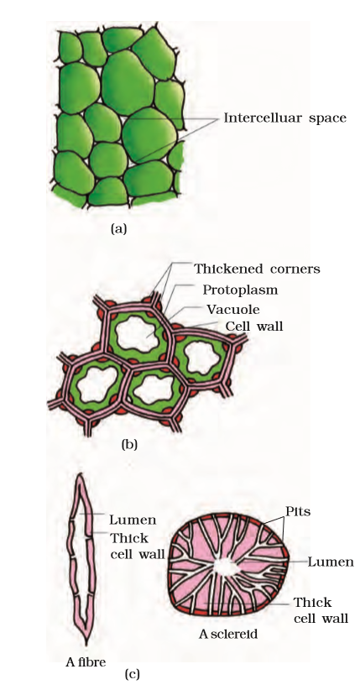
Permanent Tissues:
The cells of this tissue do not generally divide further.
Simple Tissues : It is made up of only one type of cells
Parenchyma :
Major component within organs
Cells are generally isodiametric
They may be Spherical, oval, round , polygonal or elongated.
Walls are thin and made up of cellulose.
Cells are either closely packed or have small intercellular spaces.
Functions: Perform photosynthesis, storage & secretion

Slide 14
Collenchyma
Occurs in layers below the epidermis in most dicot plants
Consists of cells with much thickened corners due to deposition of cellulose, hemicellulose and pectin.
Cells are spherical ,oval or polygonal and often contain chloroplast.
intercellular spaces are absent-
Functions : Provide mechanical support to the growing parts such as Young stem, Petiole.

Slide 15
(c) Sclerenchyma
It consists of long, narrow cells with thick and lignified cell walls having a few or numerous pits. They are usually dead and without protoplasts
Function: Provides mechanical support to organs.
Fibres
They are thick- walled, elongated and pointed cells, generally occurring in groups.

Slide 16
Sclereids
They are spherical, oval or cylindrical Highly thickened dead cells with very narrow cavities (lumen).
These are found in- Fruit walls of nuts, Pulp of fruits like guava, pear and sapota. Seed coats of legumes, Leaves of tea.

Slide 17
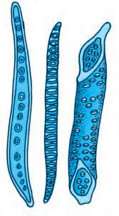
COMPLEX TISSUES
1. XYLEM
It is a conducting tissue for water and minerals from roots to the stem and leaves.
It is composed of 4 kinds of elements: tracheids, vessels, xylem fibers and xylem parenchyma.
1.Tracheids
  A kind of xylem element having elongated tube like dead cells with thick and lignified walls and tapering ends.
  Protoplasm is absent.
  In flowering plants, main water transporting elements are Tracheids & Vessels.

Slide 18
2.Vessels
A kind of Xylem element which is a long cylindrical tube-like structure
made up of many cells (vessel members), each with lignified walls and a large central cavity
protoplasm absent.
Vessel members are interconnected through perforations in their common walls.
The vessels are a characteristic feature of angiosperms.

Slide 19
3. Xylem fibres
A kind of Xylem element which have highly thickened walls and obliterated central lumens. They are septate or aseptate.
4.Xylem Parenchyma
  A kind of Xylem element which is living and thin-walled cells with cellulosic cell walls and store food materials (starch or fat) and other substances like tannins.
  Radial conduction of water takes place by ray parenchymatous cells.

Slide 20
  The first formed primary xylem: Protoxylem
  Later formed primary xylem: Metaxylem
  In stems, the protoxylem lies towards the centre (pith) and the metaxylem lies towards the periphery of the organ. This type of primary xylem is called Endrach.
  In roots, the protoxylem lies towards periphery and metaxylem lies towards the centre. Such arrangement of primary xylem is called Exarch.

Slide 21
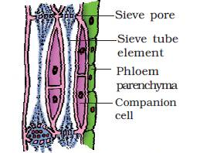
(b) Phloem
It transports food materials from leaves to other parts.
In angiosperms, phloem is composed of sieve tube elements, companion cells, phloem parenchyma & phloem fibres.

Slide 22
Sieve-tubes:
  Long tube like structures, arranged longitudinally
  Associated with Companion cells
  End wall are perforated to form sieve plates
  A mature sieve element has a peripheral cytoplasm and a large vacuole but lacks nucleus
  Function of sieve tubes controlled by nucleus of Companion cells

Slide 23
(ii) Companion cells:
These are specialized parenchymatous cells
closely associated with sieve tube elements
Companion cells are connected with sieve tubes by pit fields present between their common longitudinal wall.
The companion cells play an important role in the maintenance of pressure gradient in the sieve tubes

Slide 24
Phloem parenchyma:
  Made up of elongated , tapering cylindrical cells having dense cytoplasm and nucleus.
  Cell wall made up of cellulose. It has pits through which plasmodesmatal connections exist between the cells.
  Absent in most monocotyledons.
  Functions: Storage of food materials and other substances like Mucilage , Latex and Resins.

Slide 25
(iv) Bast fibers or phloem fibres :
Elongated unbranched sclerenchymatous cells having pointed, needle like apices and thick wall.
At maturity , they lose protoplasm and become dead.
Phloem fibres of jute, flax and hemp are used commercially.
Found in secondary Phloem. Generally absent in primary Phloem
The first formed primary phloem consists of narrow sieve tubes and is referred to as protophloem and the later formed phloem has bigger sieve tubes and is referred to as metaphloem.

Slide 26
Class Assignment
The parenchymatous cells are
1. Dead 2. Thick-walled
3. Thin-walled 4. Thick-walled and dead
Sclereids are commonly found in
1. Young stems and petioles of leaves 2. Fruit walls of nuts
3. Roots 4. Fleshy stems
Collenchyma is
1. Living and contains protoplasm
2. Dead and hollow
3. Dead and filled with reserve food
4. Living and contains no reserve food

Slide 27
10. Which of the following tissue provide maximum mechanical support to plant organs?
1. Sclerenchyma 2. Collenchyma
3. Parenchyma 4. Aerenchyma
11. The function of sieve tubes are controlled by
1. Cytoplasm of sieve tube cells
2. Nucleus of sieve tube cells
3. Nucleus of companion cells
4. Cytoplasm of companion cells
12. In stems, the protoxylem lies’ towards the _____ A ____ and the metaxylem lies towards the _____ B ____. Here A and B refers to
1. A – Periphery of the organ, B – pith
2. A – Pith, B – Periphery of the organ
3. A – Pith, B – Root centre

Slide 28
13. A mature sieve tube differs from a vessel in
1. Lacking a functional nucleus 2. Absence of lignified walls
3. Being nearly dead 4. Lacking cytoplasm
14. Which element of xylem is the characteristic feature of angiosperms?
1. Tracheid’s 2. Phloem 3. Vessels 4. Xylem fibre
15. The central lumens are obliterated in
1. Xylem fibres 2. Phloem parenchyma
3. Xylem parenchyma 4. Sieve tubes
16. All the xylem elements, when mature, and dead except
1. Tracheid’s 2. Vessels
3. Xylem parenchyma 4. Xylem fibres

Slide 29

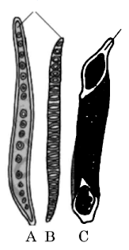
17. On the basis of following features, identify the xylem element
1. Tubular structure 2. No tapering ends
3. Dead cells 4. Absent in gymnosperms
18. Identify A, B and C in the drive diagram,
1. A - Tracheid, B - Tracheid, C – Vessels
2. A - Vessels, B - Tracheid, C – Companion cell
3. A – Companion Cell, B – Vessels, C – Tracheid
4. A – xylem fibre, B – Vessels, C – Vessels

Slide 30
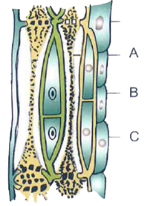
19. In the given diagram of phloem tissue, identify A, and C
1. A – Sieve tube cells, B – Xylem parenchyma, C – Companion cell
2. A – Sieve tube cells, B – Phloem Parenchyma, C – Companion cell
3. A – Sieve pore, B – Xylem parenchyma, C – Companion cell
4. A – Sieve pore, B – Phloem parenchyma, C – Companion Cell

Slide 31
20. Statement I: The end walls of sieve tube elements are perforated in a sieve-like manner to form the sieve plates.
Statement II: The companion cells help in maintain the pressure in the sieve tubes
Read the following statement and select the correct option
1. Both Statement – I and Statement – II are correct
2. Statement – I is correct but Statement – II is incorrect
3. Statement – I is incorrect but Statement – II is correct
4. Both statement – I and Statement – II are incorrect

Slide 32
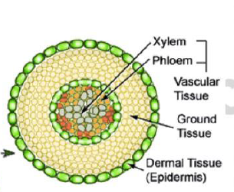
The Tissue System:
On the basis of their structure & location, there are three types of tissue systems in plants.
Based on structure and location, tissue systems are 3 types
1. Epidermal tissue system
2. Ground (fundamental) tissue system
3. Vascular (conducting) tissue system

Slide 33
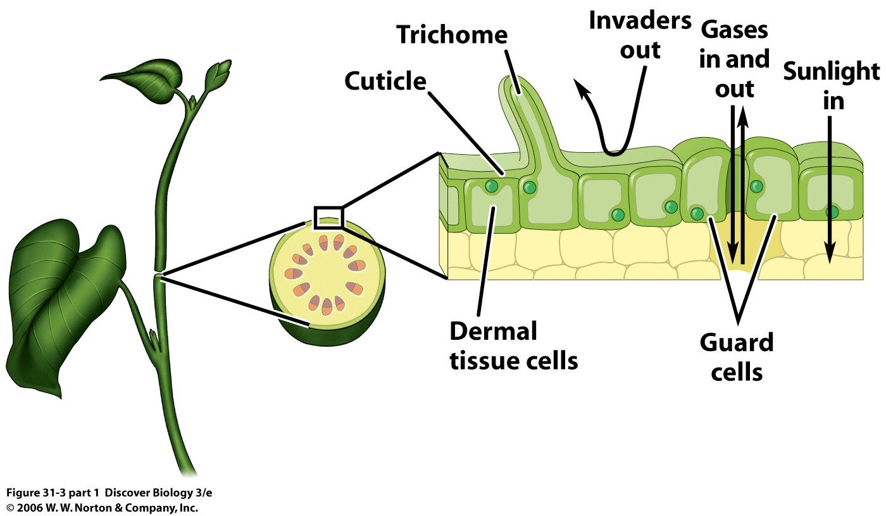
1. THE EPIDERMAL TISSUE SYSTEM
It forms the outer-most covering of the whole plant body.
It includes epidermal cells, stomata and epidermal appendages (trichomes & root hairs).

Slide 34
EPIDERMIS
It is the outermost layer of the primary plant body.
Epidermis is usually single layered.
It is made up of elongated, compactly arranged parenchymatous cells with few cytoplasm lining the cell wall and a large vacuole.
The outside of the epidermis is often covered with a waxy thick layer (cuticle). It prevents loss of water.
Cuticle is absent in roots.

Slide 35
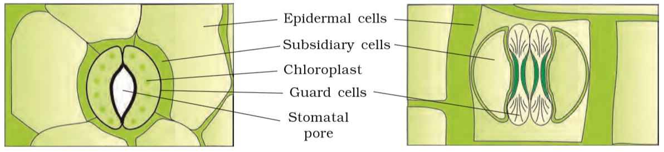
STOMATA
The pores present in the epidermis of leaves.
They regulate transpiration & gaseous exchange.
A stoma is made of two bean-shaped cells (guard cells).
In grasses, the guard cells are dumbbell shaped.

Slide 36
■ Outer walls of guard cells (away from stomatal pore) are thin and inner walls (towards stomatal pore) are thick.
■ Guard cells possess chloroplasts and regulate the opening and closing of stomata.
■ Sometimes, some epidermal cells surrounding the guard cells become specialized in shape and size. They are called subsidiary cells.
■ Stomatal aperture, guard cells and subsidiary cells together form stomatal apparatus.

Slide 37
Root hairs:
Root hairs are the epidermal appendages of roots. They are unicellular elongations of the epidermal cells.
It helps in absorption of water and minerals from the soil.
Trichomes:
The epidermal hairs on the stem are called trichomes.
They are usually multicellular.
They help in preventing the water loss due to transpiration.
Lenticels:
They are lens shaped openings found on the woody stems.
They permit the exchange of gases between the atmosphere and the internal tissue of the stem.

Slide 38
2. THE GROUND TISSUE SYSTEM
All tissues except epidermis and vascular bundles constitute the ground tissue.
It consist of simple tissues
Parenchymatous cells are present in cortex, pericycle. pith and medullary rays, in the primary stems and roots
In leaves, the ground tissue consists of thin-walled chloroplast containing cells and is called mesophyll.

Slide 39
3. THE VASCULAR TISSUE SYSTEM
It consist of Xylem and phloem. Xylem and phloem together constitute Vascular bundles.
Open type vascular bundles: Cambium is present between phloem and xylem. So vascular bundles can form secondary xylem and phloem tissues.
Open type vascular bundles present in dicotyledonous stems.
Closed Type Vascular Bundles: Cambium is absent. Hence, they do not form secondary tissues
Closed type vascular bundles present in monocotyledons.

Slide 40
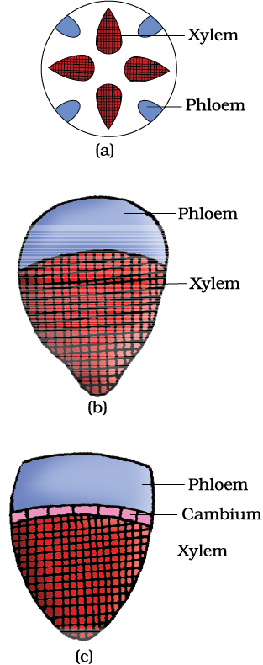
Radial type: Xylem and phloem within a vascular bundle are arranged in an alternate manner on different radii.
Radial type vascular bundles present in roots.

Slide 41
Conjoint Type
The conjoint vascular bundles usually have the phloem located only on the outer side of xylem
Xylem and phloem are situated at the same radius of vascular bundles:
Conjoint type vascular bundles present in stems and leaves.

Slide 42
Class Assignment
21. Vascular bundle without cambium is called
1. Closed vascular bundle 2. Open vascular bundle
3. Radial vascular bundle 4. Conjoint vascular bundle
22. Trichomes help in
1. Formation of epidermis
2. Process of gaseous exchange
3. preventing water loss due to transpiration
4. Origin of lateral branches

Slide 43
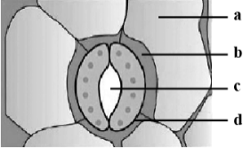
23. A typical dicot stoma is shown in the diagram with labelling A-D. Which labelling is not correctly matched with its feature/function?
1. B – These are specialized epidermal cells
2. A – Parenchymatous cell with abundant cytopiasm
3. D – Opening and closing is related with K⁺ and ABA.
4. C – Inner wall is thicker than outer wall

Slide 44
24. Select the mismatched pair
1. Root hair – Unicellular
2. Stem hair – Multicellular
3. Trichomes – Cause water loss
4. Guard cells – Regulate opening and closing of stomata
25. In grasses, shape of guard cells in stomata is
1. Dumb-bell shaped 2. Bean shaped
3. Spindle Shaped 4. Pyriform shaped

Slide 45
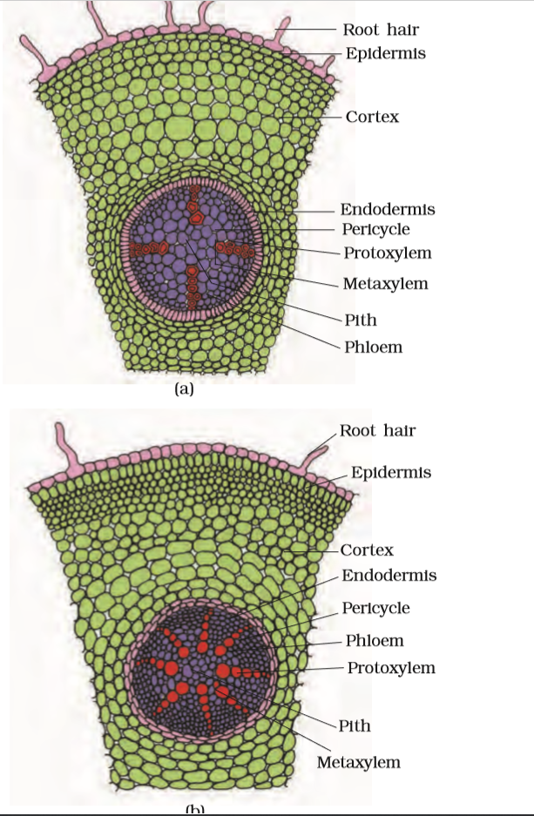
ANATOMY OF DICOT AND MONOCOT PLANTS
1. DICOT ROOT

Slide 46
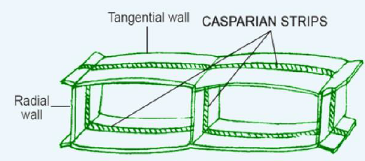
Outermost layer is Epiblema (Epidermis). Many cells of Epiblema protrude in the form of unicellular root hairs.
The cortex consists of several layers of thin-walled parenchyma cells with intercellular spaces.
The innermost layer of the cortex is called endodermis
Endodermis comprises a single layer of barrel-shaped cells without any intercellular space
The tangential as well as radial walls of the endodermal cells have a deposition of water impermeable, waxy material-suberin-in the form of casparian strips.

Slide 47
Next to endodermis lies a few layers of thick walled parenchymatous cells referred to as pericycle
Stele : All tissues on the inner side of the endodermis
Pith is small or inconspicuous.
Conjunctive tissue: The parenchymatous cells which lie between the xylem and the phloem.
There are usually 2-4 xylem and phloem patches in dicotyledonous (dicot) root.

Slide 48
2. Monocot Root
The anatomy of the monocot root is similar to the dicot root in many respects. It has epidermis, cortex, endodermis, pericycle, vascular bundles and pith.
Polyarch condition is found ( More than six vascular bundles)
Pith is large and well developed.
They do not undergo any secondary growth.

Slide 49
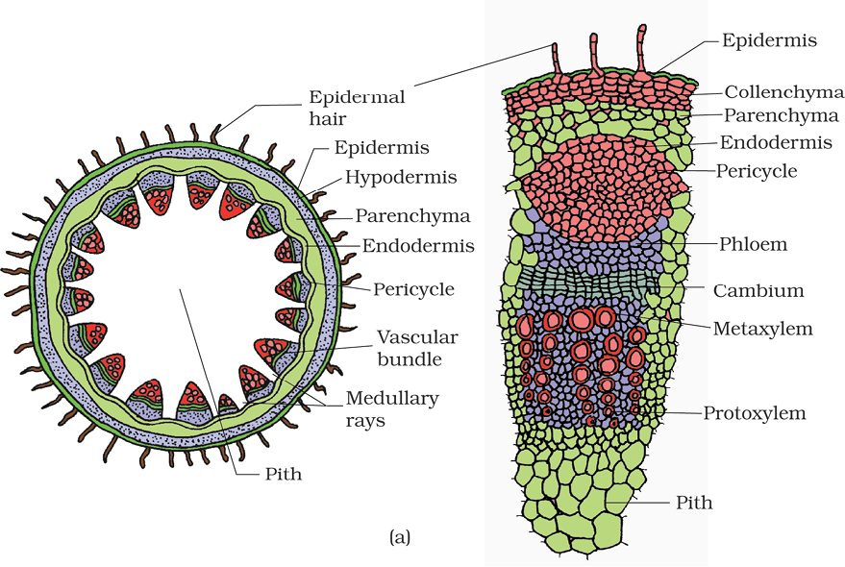
1. DICOT STEM

Slide 50
EPIDERMIS
• Outermost protective layer.
• Covered with a thin layer of cuticle, it may bear trichomes & few stomata.
CORTEX
• Multiple layers of the cells arranged in between epidermis and pericycle.
• It consists of 3 sub-zones:
    Hypodermis
    Cortical layers
    Endodermis

Slide 51
Hypodermis
Outer zone just below epidermis. Consists of a few layers of collenchyma. Provides mechanical strength to young stem.
Cortical layers: Below hypodermis. Consist of rounded thin walled parenchyma cells with conspicuous intercellular spaces.
Endodermis: Innermost layer. Cells are rich in starch grains. So it is also called starch sheath.

Slide 52
STELE: Consists of the following parts:
Pericycle: Present on the inner side of the endodermis and above phloem as semi-lunar patches of sclerenchyma.
Medullary rays: Few layers of radially placed parenchyma cells between vascular bundles.
Vascular bundles: Large number. Conjoint & open. Their ring arrangement is a characteristic of dicot stem. Protoxylem is endarch.
Pith: Central part. Many round, parenchymatous cells with large intercellular spaces.

Slide 53
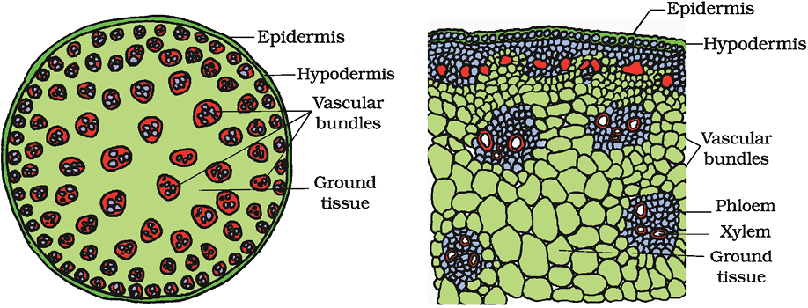
2. MONOCOT STEM

Slide 54
A sclerenchymatous hypodermis is present.
A large number of scattered vascular bundles, Sclerenchymatous bundle sheath, and a large conspicuous parenchymatous ground tissue are the characteristic features of monocot stem.
Peripheral vascular bundles are smaller than centrally located ones
Vascular bundles are conjoint and closed.
The phloem parenchyma is absent in monocot stem.
Water – containing cavities are present within the vascular bundles.

Slide 55
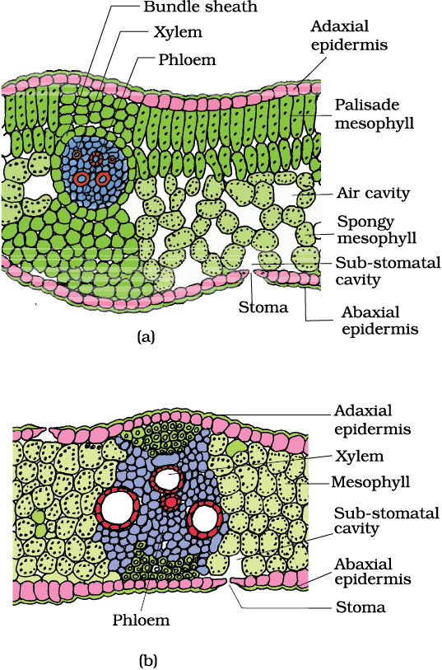
1. DORSIVENTRAL (DICOT) LEAF

Slide 56
EPIDERMIS:
Adaxial epidermis: Upper Epidermis
Abaxial epidermis: Lower Epidermis
A conspicuous cuticle is present.
Abaxial epidermis generally bears more stomata than the adaxial epidermis. The latter may even lack stomata.
MESOPHYLL:
The tissue between the upper and the lower epidermis.
It is made up of Parenchyma that contains chloroplasts
It is of 2 types:
    Palisade parenchyma
    Spongy parenchyma

Slide 57
Palisade parenchyma: Mesophyll is adaxially placed & made up of elongated cells arranged vertically and parallel to each other.
Spongy parenchyma: Mesophyll is oval or round and loosely arranged & situated below the palisade cells and extends to the lower epidermis. There are numerous large spaces and air cavities between these cells.
vascular bundles are seen in the veins and midrib.
The veins vary in thickness in reticulate venation of dicot leaves
Vascular bundles are surrounded by a layer of thick walled Bundle sheath cells.

Slide 58
2. ISOBILATERAL (MONOCOT) LEAF
It is like that of dicot leaf in many ways.
It shows following differences:
  Stomata are present on both surfaces of the epidermis.

Slide 59
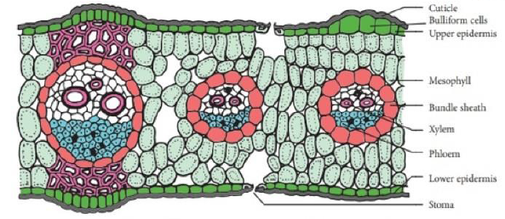
  Mesophyll is not differentiated into palisade and spongy parenchyma.
  In grasses, certain adaxial epidermal cells along the veins modify themselves into large, empty, colourless cells. These arc called Bulliform cells.
  Bulliform cells helps to minimize water loss.
  Parallel venation is reflected in the near similar sizes of vascular bundles (except in main veins) as seen in vertical sections of the leaves.

Slide 60
Class Assignment
26. In root, the tangential as well as radial walls of the barrel-shaped endodermal cells have a deposition of water impermeable, waxy material suberin in the form of
1.Cuticle strip 2. Protein strips
3. Casparian strips 4. Sillicious strips
27. Which type of arrangement of vascular bundles occurs in the roots of monocots?
1. Conjoint open 2. Radial
3. Conjoint closed 4. Bicollateral

Slide 61
28. Polyarch xylem bundles are found in
1. Monocot root 2. Dicot root
3. Monocot stem 4. Dicot stem
29. Parenchyma cells in between xylem and phloem bundles in roots are called
1. Complimentary tissue 2. Conjuctive tissue
3. Medullary rays 4. Pith
30. Vascular bandles surrounded by bundle sheath cells can be observed in
1. Monocot stem 2. Monocot leaf
3. Dicto root 4. Dicto leaf

Slide 62
31. The ring arrangement of vascular bundle is the characteristic feature of
1. Dicot root 2. Monocot root
3. Monocot stem 4. Dicot stem
32. Root differs from stem in having
1. Parenchymatous cortex 2. Pith
3. Exarch xylem 4. Pericycle
33. Which is not true for monocot stem?
1. Sclerenchymarous hypodermis
2. Presence of water canals in pith
3. Conjoint, collateral closed vascular bundles
4. Presence of bundle sheath

Slide 63
34. Which characteristic differentiates a dicot leaf from monocot leaf?
1. Stomata only on upper side
2. Differentiation of palisade and spongy parenchyma
3. Parallel venation
4. Stomata on both upper and lower sides
35. The large empty and colourless cells present at intervals on the upper surface of grass leaf are called
1. Bulliform cells 2. Palisade parenchyma
3. Spongy parenchyma 4. Accessory cells

Slide 64
36. Large number of scattered vascular bundles are present in
1. Monocot stem 2. Monocot root
3. Dicot stem 4. Dicot root
37. Radial vascular bundles characteristically occur in
1. Monocot and dicot stems 2. Monocot and dicot leaves
3. Monocot and dicot roots 4. All of these
38. A typical monocotyledonous root is characterized by
1. Usually more than six xylem bundles
2. Large and well developed pith
3. No secondary growth
4. All of these

Slide 65
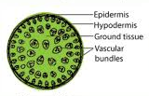
39. Given section belongs to
1. Monocot root 2. Monocot stem
3. Dicot root 4. Dicot stem
40. Identify the type of plant and its part on the basis of given features:
A. Cambium – Develops later B. Pith – Small or inconspicuous
C. Epidermis – Possess unicellular hairs
1. Dicot stem 2. Monocot stem
3. Dicot root 4. Monocot root

Slide 66
THANK YOU

